Slide 1
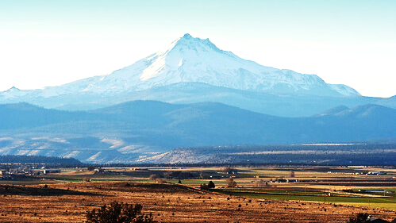
JEFFERSON COUNTY
Community Development Department
Planning Commission
Accessory Dwelling Units
April 14, 2022

Slide 2
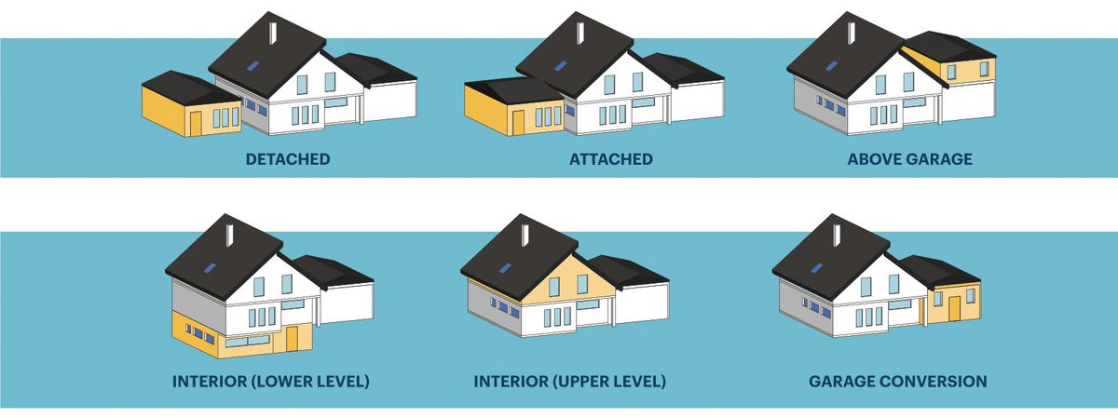
What is an accessory dwelling unit?
ORS 215.501
“Accessory dwelling unit” means a residential structure that is used in connection with or that is auxiliary to a single-family dwelling.

Slide 3
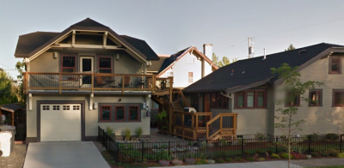
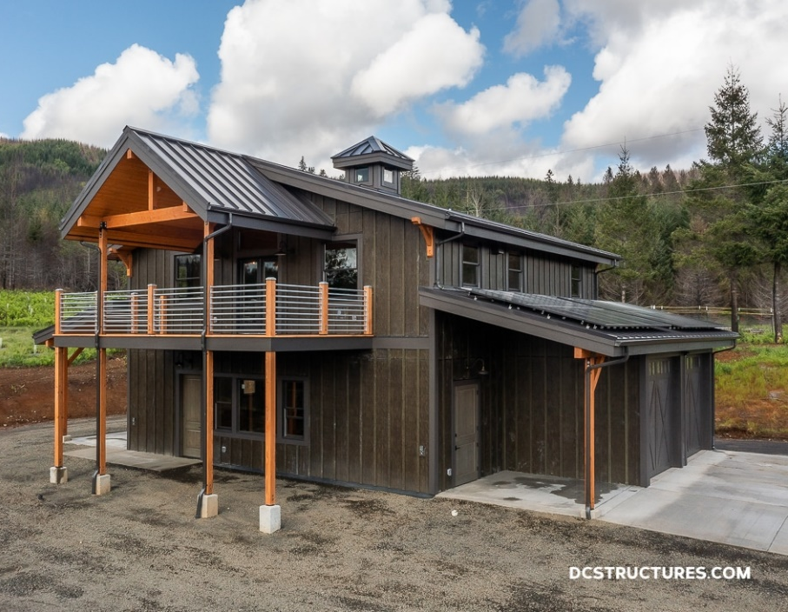
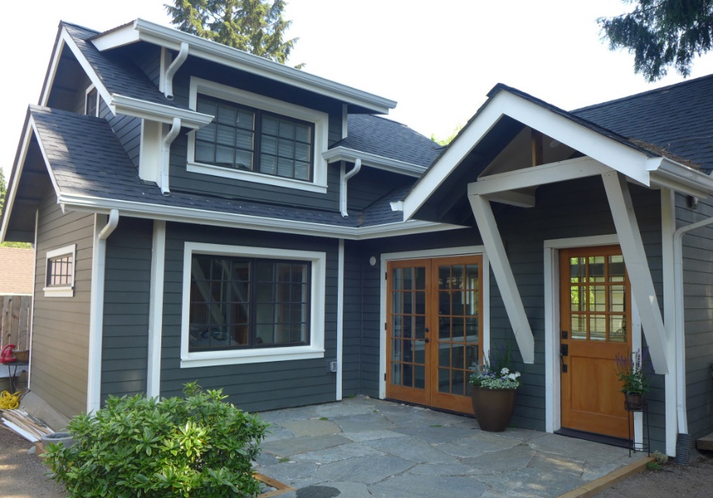
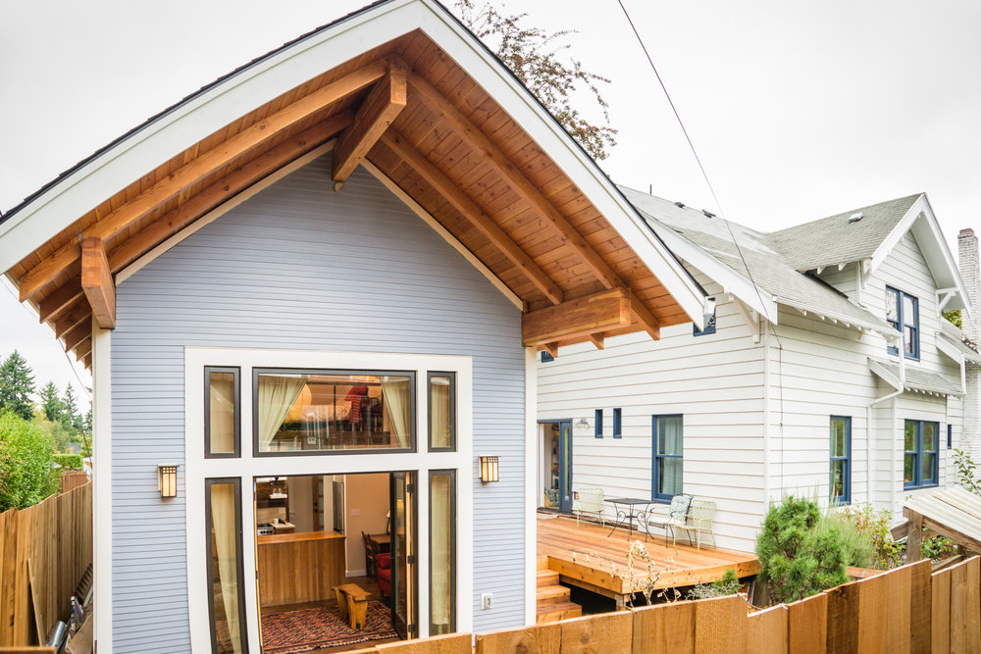
What is an accessory dwelling unit?

Slide 4
What is the purpose of ADUs?
Rental income
Additional housing / rural housing options
Separate guest quarters
Separate dwelling for family
Medical hardship*

Slide 5
Senate Bill 391 → ORS 215.495
Allows counties to adopt code amendments permitting ADUs in areas “zoned for rural residential use.”
Counties are not required to allow ADUs.
Counties may limit ADUs to specific areas.
Counties may vary standards in different zone.
Counties may adopt stricter standards than state law.
Counties may not adopt standards more lenient than state law.

Slide 6
Projected Timeframe for Considering ADUs
April 14 1st public hearing before the Planning Commission
Late April Begin discussion with CRR and 3R Boards and Residents
May 2nd public hearing before the PC (if needed)
Begin public hearings on CRR and Three Creeks (depending on interest)
June Adoption by Board of Commissioners
June 30 Dept. of Forestry adoption of Wildland-Urban Interface (WUI) Maps
* County can begin permitting ADUs in non WUI areas
December 31 State Fire Marshall adoption of Defesible Space Standards
*County can begin permitting ADUs in WUI areas

Slide 7
Minimum Lot Qualification Standards
Minimum 2 acres in size
Not located within an urban reserve area
Contains one existing single family dwelling
The existing SFD is not subject to a nuisance order
Not located in an “area of critical state concern”
Within a rural fire protection district

Slide 8
Required Development Standards
Maximum 900 s.f. “usable floor area”
Within 100 feet of the existing SFD
May not be used as a vacation rental (min. 45 days)
Complies with all laws related to sanitation & waste disposal
Maximum of one ADU per lot
Restricted from future land division/lot line adjustment
May require ADU to use the same water supply source/system

Slide 9
Minimum Development Standards
Maximum 900 s.f. “usable floor area”
Within 100 feet of the existing SFD
Restrictions on use as vacation rental
Allows conditions to be placed on vacation rentals
Complies with all laws related to sanitation & waste disposal
Maximum of one ADU per lot

Slide 10
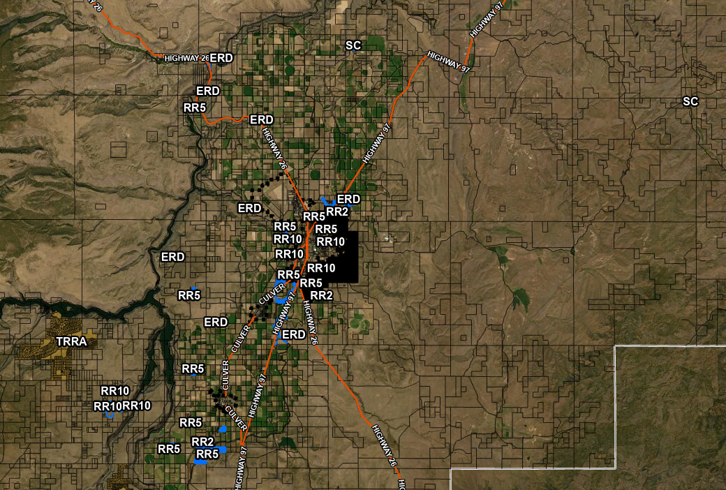

Slide 11
Northeast Madras

Slide 12
Southwest Madras

Slide 13
Culver Area

Slide 14
Culver Area

Slide 15
Culver Area

Slide 16
Culver Area

Slide 17
Culver Area

Slide 18
Warm Springs Area

Slide 19
Round Butte Area

Slide 20
Gateway

Slide 21
Questions / Discussion
Should the county amend the code to allow ADUs in any or all eligible zones?
Are the minimum standards prescribed by state law appropriate for Jefferson County or are there additional/stricter standards that should be applied?
Are there any zones in which ADUs should not be allowed or in which stricter standards should be applied?
What concerns are there that might require additional research/information?

